Slide 1
EDA CREDIT ASSIGNMENT
BHAVYA JOSHI
DS C39

Slide 2
Index
Problem Statement…………………………………………………………………………3
My Approach ……………………………………………………………………………....4
Analyzing application data through Univariate Analysis…………………………..5
Imbalance Check………………………………………………………………………….6
Analyzing application data through Multivariate Analysis……………………….19
Analyzing Previous application data through Univariate Analysis………………26
Analyzing Previous application data through Multivariate Analysis……………32
Conclusion: Positive factors (leads to Timely Repay) ……………………………..38
Conclusion: Negative factors (leads to Default) ……………………………………39

Slide 3
Problem Statement
There are two datasets provided Application Dataset and Previous Application.
When a loan is granted , the applicant may default it or pay up timely.
If the applicant is likely to repay the loan, then not approving the loan results in a loss of business to the company.
If the applicant is not likely to repay the loan, i.e. he/she is likely to default, then approving the loan may lead to a financial loss for the company.
The company wants to understand the driving factors (or driver variables) behind loan default, i.e. the variables which are strong indicators of default.

Slide 4
My Approach
Import both files through pandas. Process and analyze them sequentially.
Load Application Data file.
Routine review of the file through info , describe, head options.
Find out columns with high null percentage. Drop cols with 40% above null data.
Impute missing data for rest of columns.
Standardize data (fix negative values, rectify datatypes)
Outlier analysis and Action (Binning)
Univariate Analysis for defaulters and non-defaulters
Bivariate Analysis /Multivariate Analysis
Then same approach and steps on Previous Application data file.
Lastly merge both the files.

Slide 5
Analyzing Application Data Through Univariate Analysis

Slide 6
People who paid on time: 282412 People who paid on time: 24804 Percentage of defaulters: 8.07 % Imbalance ratio : 8.78 %
Imbalance Check

Slide 7
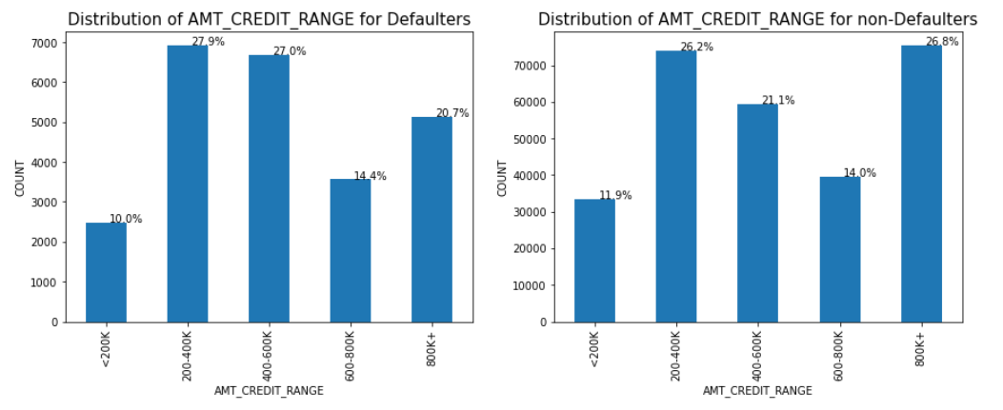
AMT_CREDIT_RANGE
Here we can see that applicants who have taken credit of 400-600K are more likely to default and applicants who have taken 800K+ credit are more likely to pay up timely.

Slide 8
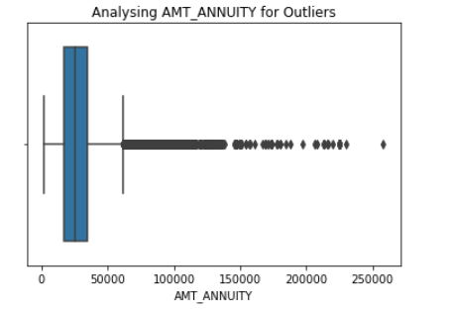
AMT_ANNUITY
AMT_ANNUITY has huge amount of outliers. The first quartiles is very slim compare to third quartile.
It means data is skewed towards first quartile.

Slide 9
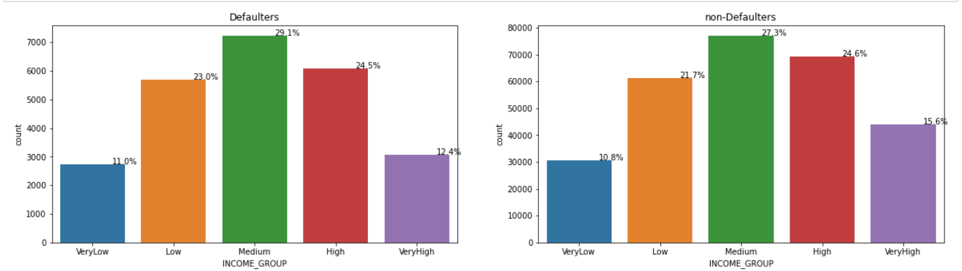
Income_Group
From the above comparison we can see people with Very Low to Medium income are pretty much inconclusive as they are both defaulters and non-defaulter at same level. However, when it comes to High and Very-High income; percentage of non-defaulters is on higher side. Very High income group is less risky.

Slide 10
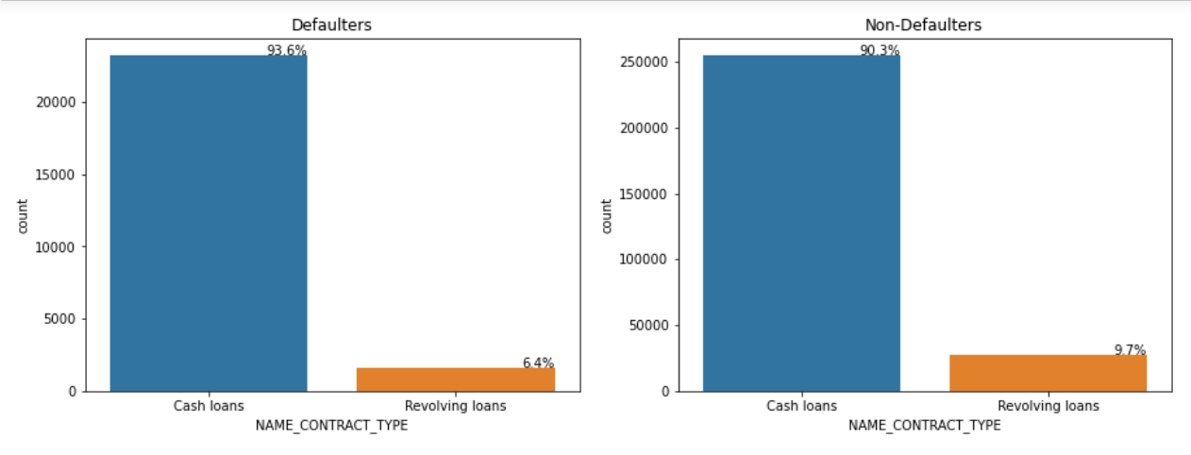
NAME_CONTRACT_TYPE
We can see from the above chart that from a bank's perspective Revolving Loans are better than Cash Loans. People default more on cash loans than on Revolving Loans

Slide 11
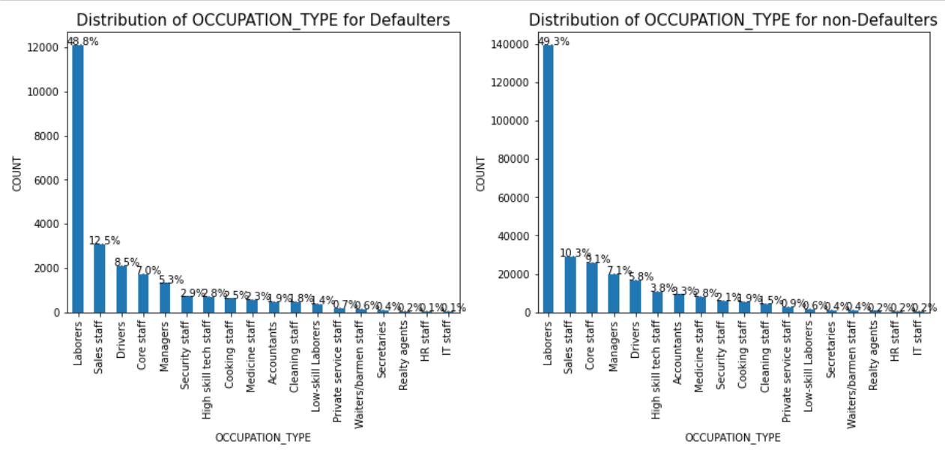
OCCUPATION_TYPE
No valuable insights observed from above chart, it can be seen that pretty much similar pattern is followed in every occupation Type.

Slide 12
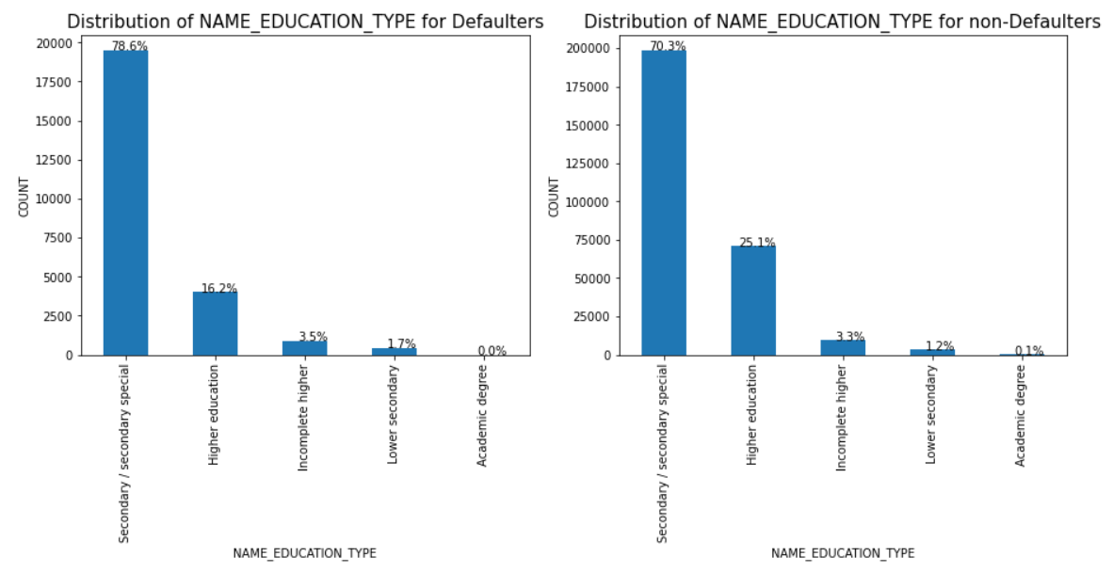
NAME_EDUCATION_TYPE
Here it is pretty clear from the above picture that people with "Higher Education" tend to pay up timely. There is a significant percentage gap between defaulters and non-defaulters for Higher education Category

Slide 13
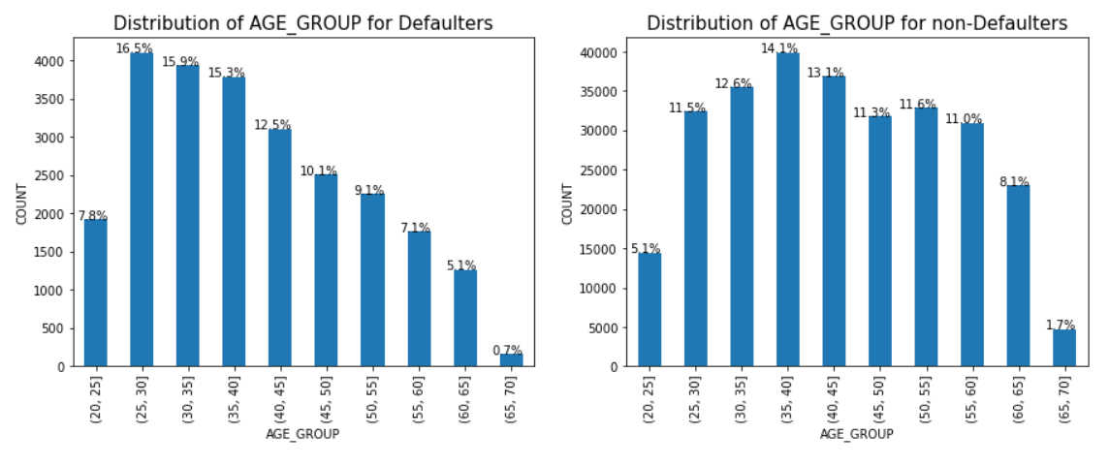
AGE_GROUP
We can interpret from above data that Age group of 25-30 is the most risky as they default the most. At the same time people in the age group of 55 - 65 are non-defaulting and most promising and will timely re-pay.

Slide 14
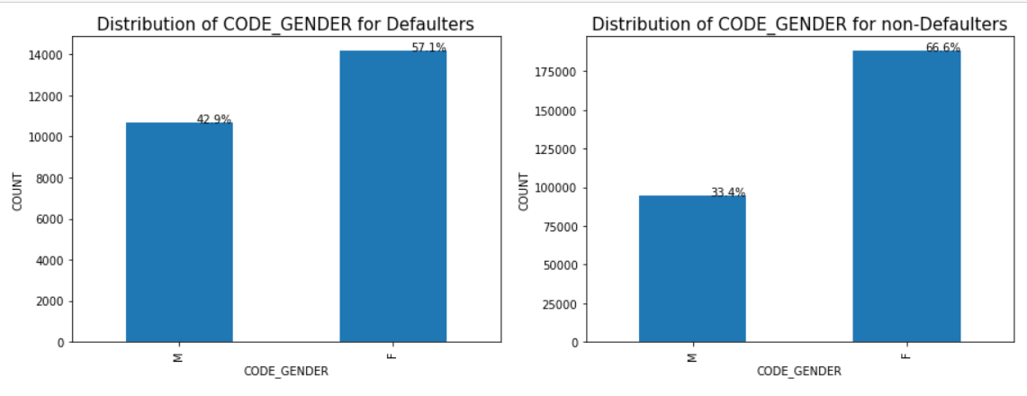
CODE_GENDER
Here we can clearly observe that Males default more than Females. So approving loans to female is comparatively safer.

Slide 15
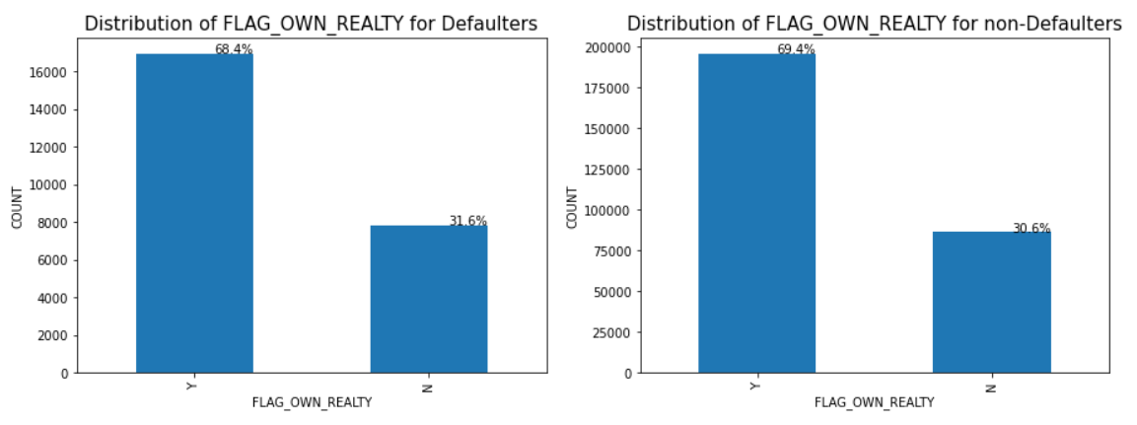
FLAG_OWN_REALTY
Owning Realty has no impact on defaulting behavior.

Slide 16
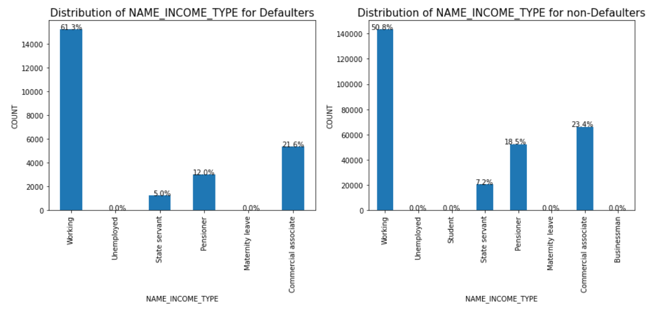
NAME_INCOME_TYPE
This is quite clear from above that "Working" class of people are more likely to default. On the other hand, State Servants and Pensioners are more likely to pay in time

Slide 17
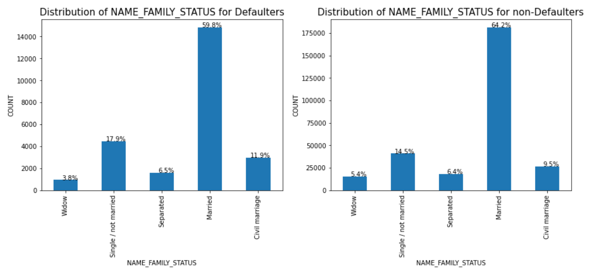
NAME_FAMILY_STATUS
Single and unmarried individuals are mostly likely to default , whereas Married set of people are highly likely to pay on time.

Slide 18
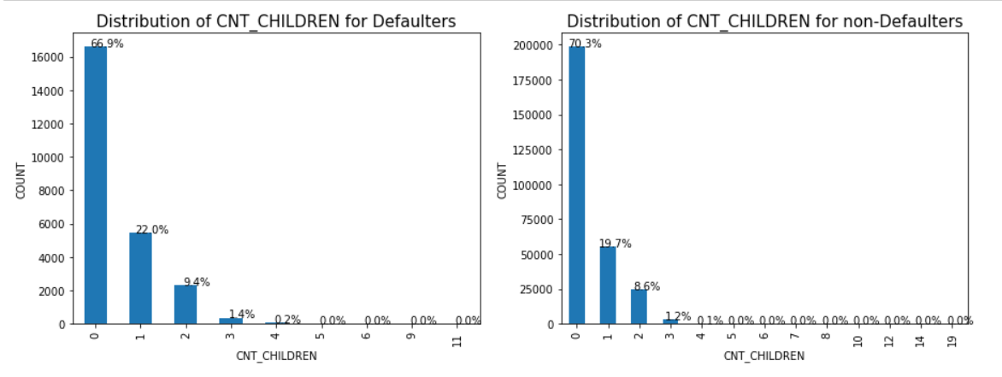
Count of Children
There is no dependency on defaulting behavior on count of children , however we can notice that people with no kids apply for loan more and eventually as the kid count increase possibility of requesting loan decreases

Slide 19
Analyzing Application Data Through Multivariate Analysis

Slide 20
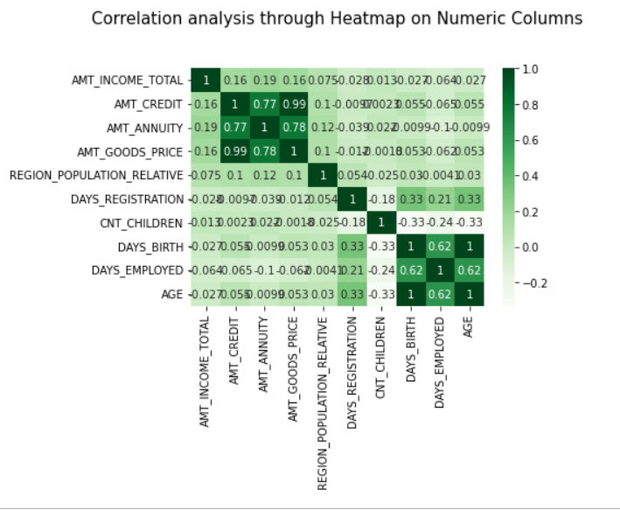
Numerical columns correlation analysis
From the above we can simply see that only three columns are corelated AMT_ANNUITY, AMT_CREDIT, AMT_GOODS_RANGE. Age (additional created column) and DAYS_BIRTH are correlated which simply is too obvious.

Slide 21
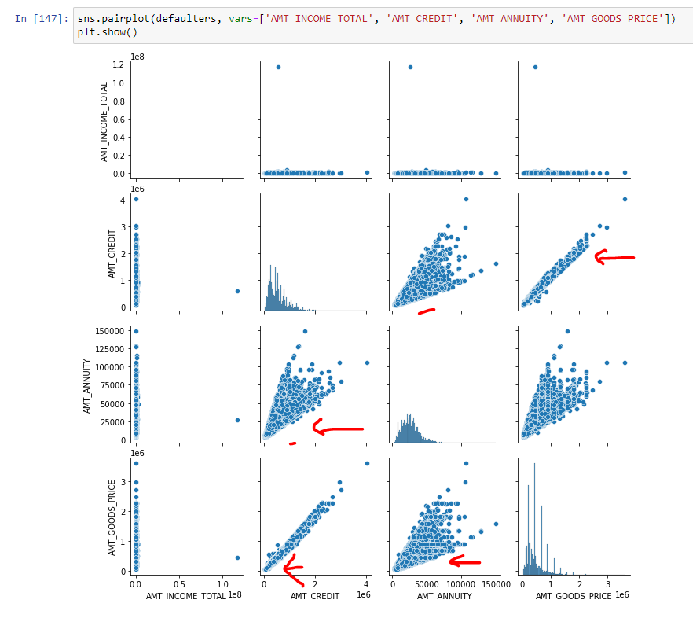
Pairplot from heatmap results
Here we can notice that as Price of Goods is high the Amount of loan requested will also be high. Which is quite obvious as people will need high loan to purchase expensive goods.
In addition to that Annuity loan is also directly linked with loan amount (AMT_CREDIT)

Slide 22
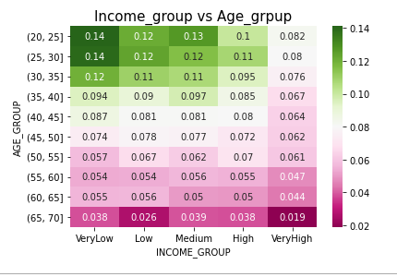
Income group vs Age_group
Here dark green denotes probability of default and dark pink denotes high probability of timely Payment. People with age group of 65 and above but Low and Very High Income are safer. Young People with Low income are risky. The heatmap is also inline with common understanding that young age people's income is mostly low and old age people mostly have good income.

Slide 23
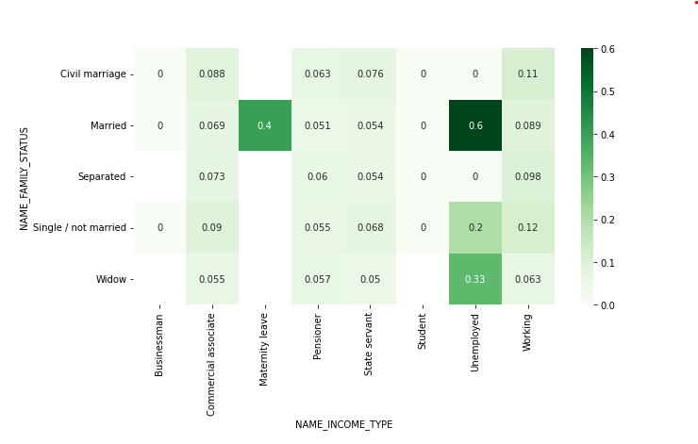
Heatmap of Family Status vs Income Type
Married people who are unemployed or on maternity are highly likely to default the payments.

Slide 24
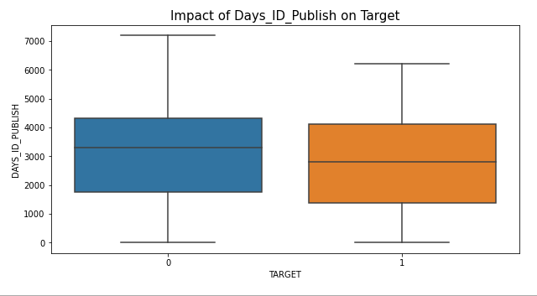
Impact of Days_ID_Publish on Target
Here we can infer that people who have recently changed the ID are more likely to default

Slide 25
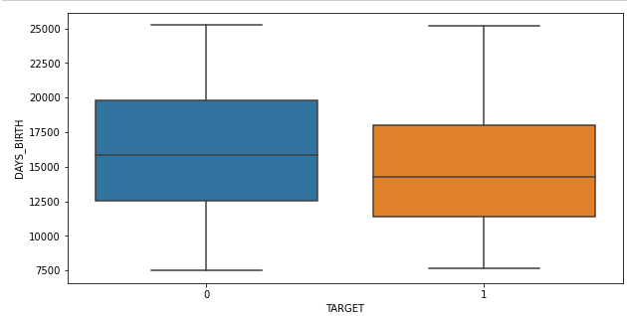
Comparison of Age Median with Target
Here We can infer from above that people with higher age are more likely to pay up the loan.

Slide 26
Analyzing Previous Application Data File Through Univariate Analysis

Slide 27
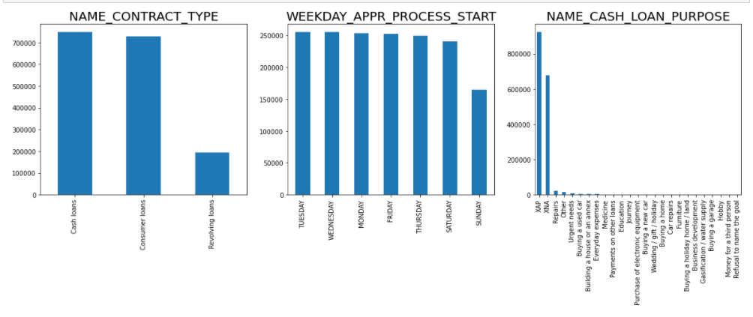
Univariate Analysis
From the above it is evident that Frequency of Cash Loans is high, Maximum loans are done on Tuesday and "Repairs" are the reason for majority of loans in Previous application dataset.

Slide 28
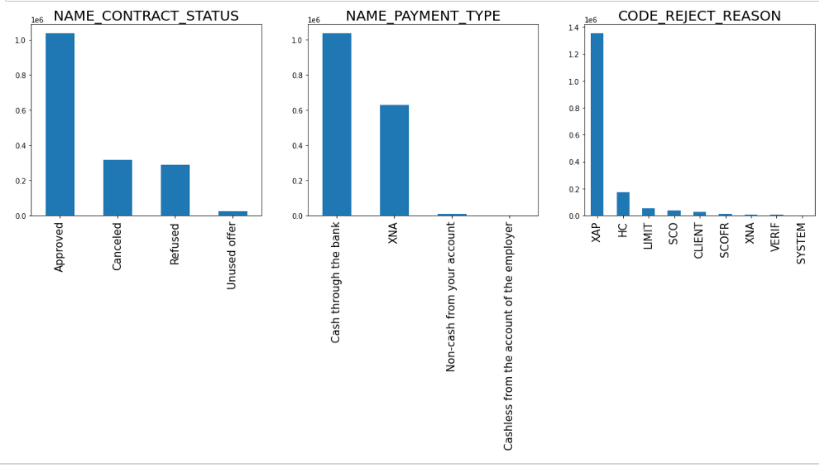
Univariate Analysis
We can see that majority of the loans were actually Approved.
For 'NAME_PAYMENT_TYPE' and 'CODE_REJECT_REASON' Cash through the bank and HC has the maximum value.

Slide 29
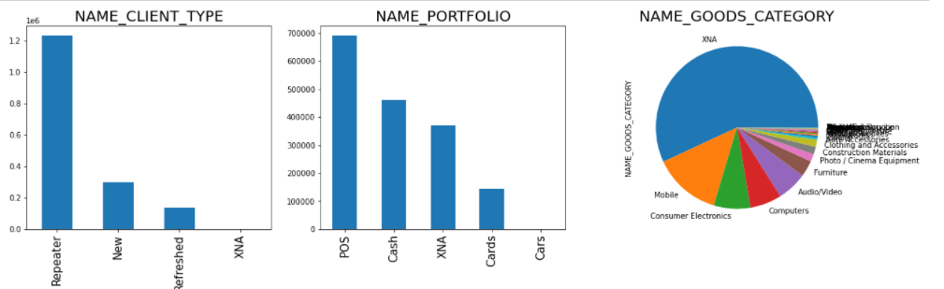
Univariate Analysis
We can see that maximum set of loan requestors were repeater. Maximum loans are requested to buy phones; Payments are done through POS

Slide 30
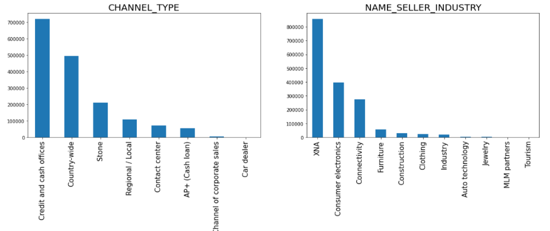
Univariate Analysis
Credit and Cash Offices are the highest Channel Types and Consumer Electronics is the highest count industry of seller.

Slide 31
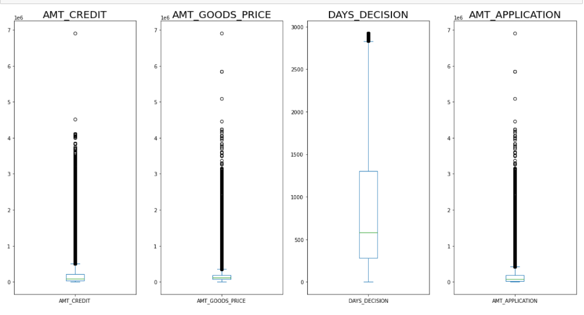
Univariate Analysis – Outlier check
For DAYS_DECISION median is around 500 days, which means generally people apply for another loan after 2 years . However for other columns we can see the outlier data is huge

Slide 32
Analyzing Previous Application Data File Through Multivariate Analysis

Slide 33
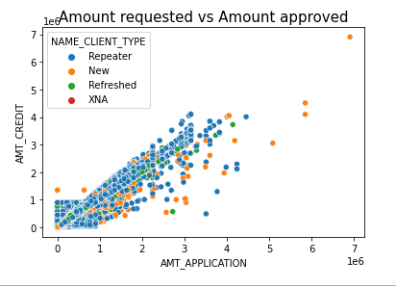
ScatterPlot of Amt_Application vs Amt_Credit
We can see from above that loan passed(AMT_CREDIT) is always equal or lower than loan requested (AMT_APPLICATION). However if the amount is below 10,00,000 then loan passed is even more than requested but that is only happening for Repeaters.

Slide 34
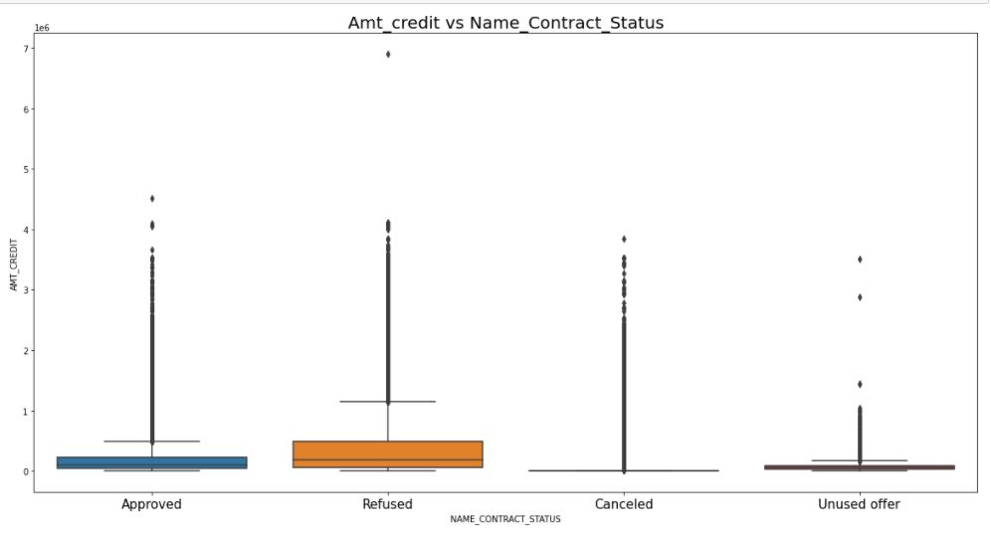
BoxPlots on Amt_Credit vs Name_Contract_Status
When the loan amount is too low it may end up as cancelled or unused by the applicant

Slide 35
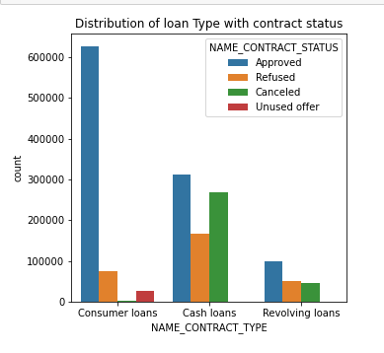
Distribution of Loan Type with Contract Status
From the above we can deduce that Consumer Loans get approved very easily in comparison to others.
Most of the applications are for Cash loan and Consumer loan.
Although the cash loans are refused more often than others and Consumer Loans get approved very easily in comparison to others.

Slide 36
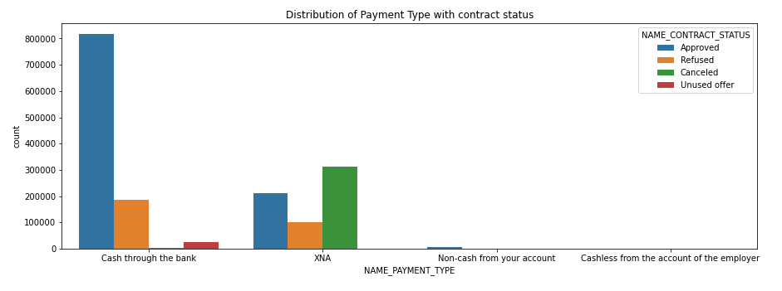
Distribution of Payment Type with Contract Status
Here we can clearly see that people prefer to repay the loan directly throuch to the bank

Slide 37
Conclusion

Slide 38
Positive factors (leads to Timely Repay)
Company should grant more Revolving Loans as they default less hence beneficial.
Applicants with 800K+ loans default less
Very High Income group (Income 2,25,000+) defaults less
Higher education people pay up timely.
Old age groups 55-65 are very safe to grant loans.
Females default less compared to Males.
State Servants and Pensioners are more likely to pay timely.
As the kids count increases , frequency of people applying loan decreases.
As Price of Goods is high the Amount of loan requested will also be high. Which is quite obvious as people will need high loan to purchase expensive goods.
Old age people have generally high income and pay up timely.
Maximum loans are done on Tuesday.
For DAYS_DECISION median is around 500 days, which means generally people apply for another loan after 2 years .
Consumer Loans get approved very easily in comparison to others.
Most of the applications are for Cash loan and Consumer loan. Cash loans are refused more often and Consumer Loans get approved very easily.
People prefer to repay the loan directly through to the bank.

Slide 39
Negative factors (leads to Default)
More Defaults on cash loans.
Age group of 25-30 most risky.
Working class people default more.
Single and Unmarried default more.
Young age people have generally low income and default more.
Married people who are unemployed or on Maternity likely to default more.
Applicants who have changed the ID recently are more likely to default.
Maximum set of loan requestors were repeater. Maximum loans are requested to buy phones; Payments are done through POS.
Frequency of Cash Loans is high, and they default more as well.
Loan passed(AMT_CREDIT) is always equal or lower than loan requested (AMT_APPLICATION). However if the amount is below 10,00,000 then loan passed is even more than requested but that is only happening for Repeaters.
When the loan amount is too low it may end up as cancelled or unused by the applicant.

Slide 40
Thank You

